Slide 1
Data structure & Algorithm Analysis
Topic 7
Searching

Slide 2
CHAPTER CONTENT
01
Overview of Searching
02
Common Search Techniques: Linear Search vs Binary Search
03
Searching in Sorted and Unsorted Array

Slide 3
Overview of searching

Slide 4

What is Searching?
Searching is the process of finding a given value position in a list of values.
It decides whether a search key is present in the data or not.
It is the algorithmic process of finding an item in a collection of items.
It can be done on internal data structure or on external data structure.
Searching techniques includes : Sequential Search and Binary Search

Slide 5
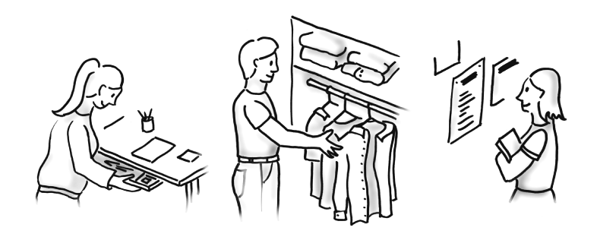
Searching in Real life Example
Fig. 1: Searching is an everyday occurrence.

Slide 6
Type of Searching Algorithm
Linear search
Binary search
Also known as sequential search.
The linear search starts searching from the starting to ending point.
Binary search works on the principle of divide and conquer.
Binary searching starts from the middle point.

Slide 7
Linear search

Slide 8
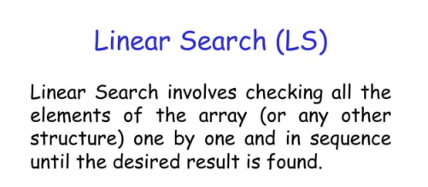

Slide 9
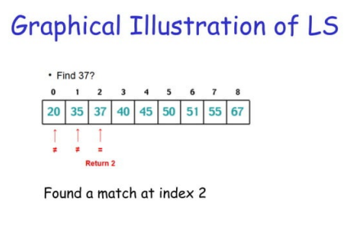

Slide 10
Algorithm
Linear Search ( Array A, Value x)
Step 1: Set i to 1
Step 2: if i > n then go to step 7
Step 3: if A[i] = x then go to step 6
Step 4: Set i to i + 1
Step 5: Go to Step 2
Step 6: Print Element x Found at index i and go to step 8
Step 7: Print element not found
Step 8: Exit

Slide 11
Pseudocode
procedure linear_search (list, value)
for each item in the list
if match item == value
return the item's location
end if
end for
end procedure

Slide 12
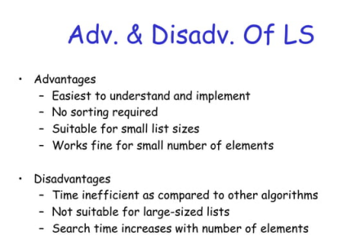
Advantage & disadvantages

Slide 13
Binary search

Slide 14
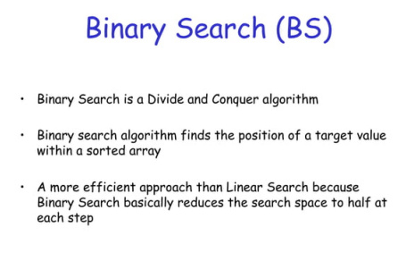

Slide 15
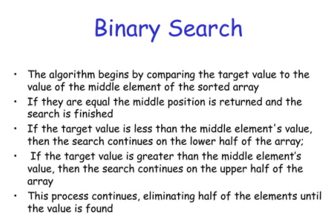

Slide 16
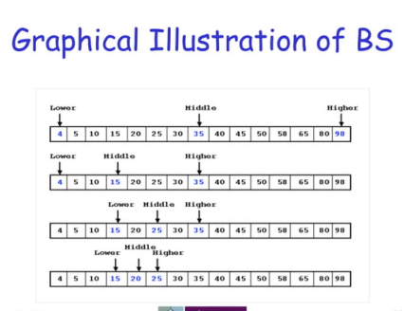

Slide 17
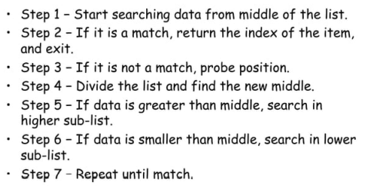
Algorithm

Slide 18
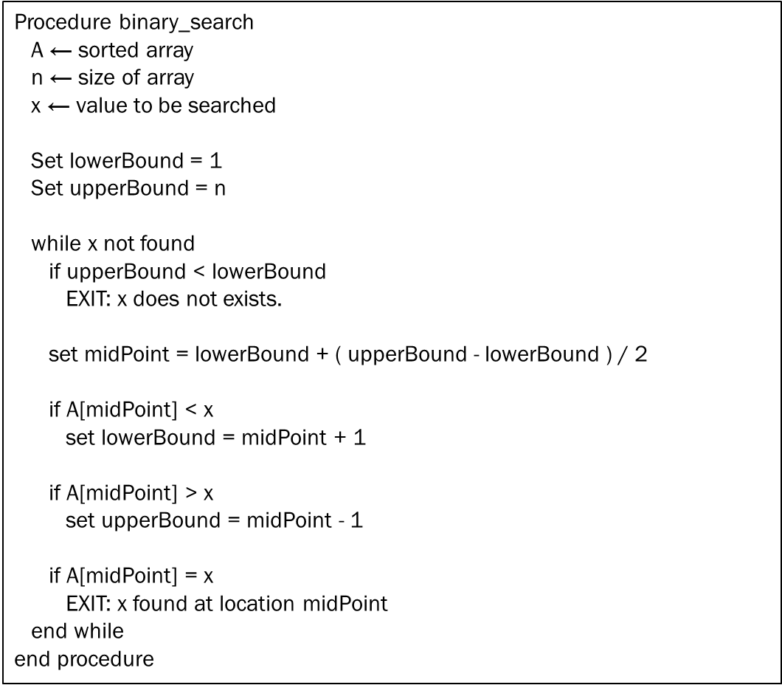
Pseudocode

Slide 19
Searching in array

Slide 20
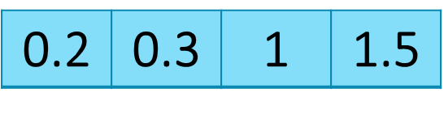
Sorted array
Sorted array is an array where each element is sorted in numerical, alphabetical, or some other order, and placed at equally spaced address in computer memory.
1 2 3 4

Slide 21
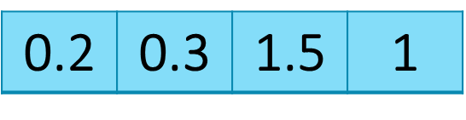
Unsorted array
Unsorted array is an array where each element is not sorted in numerical, alphabetical, or some other order, and placed at equally spaced address in computer memory.
1 2 3 4

